Slide 1

Python Advanced
Course Introduction
SoftUni Team
Technical Trainers
Software University
https://softuni.bg/

Slide 2
Table of Contents
Course Objectives
Training and Team
Course Organization
Course Infrastructure
Evaluation Criteria
2

Slide 3
Have a Question?
sli.do
#python-advanced

Slide 4











SoftUni Diamond Partners

Slide 5


Educational Partners

Slide 6

Course Objectives

Slide 7
Python Advanced Objectives
Working with Lists as Stacks and Queues
Working with Tuples and Sets
Creating and working with Multidimensional Lists
Learning functional programming
Working with Files
Handling Exceptions
7

Slide 8
Practical Programming Exam
Exam – 4 hours
3 practical problems
Stacks and Queues
Multidimensional Lists
Functions
8

Slide 9
Theoretical Exam
You will have 30 minutes once you enter
Multiple-choice with 1 correct answer
Test will be in English
Automated quiz system
Available on the day of the practical exam
You can submit your answers just one time
9

Slide 10

The Team

Slide 11
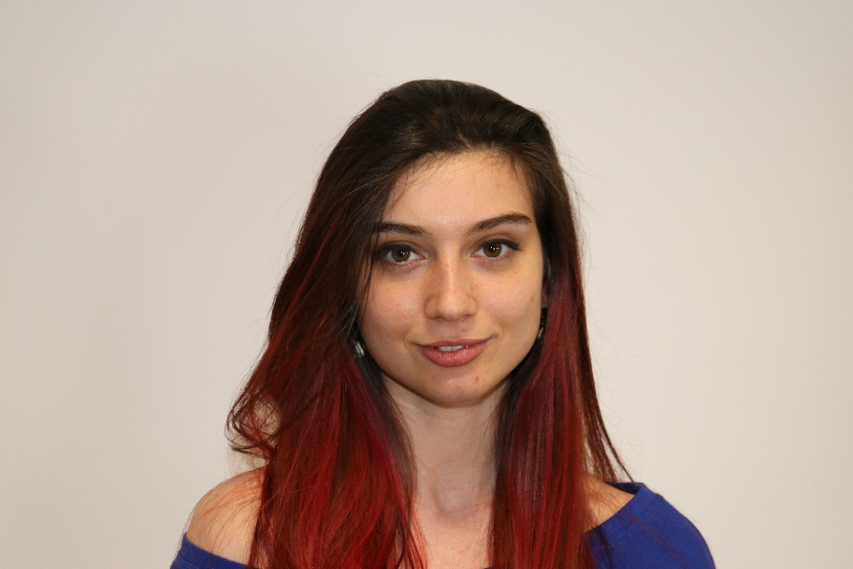
Ines Ivanova
Senior Software Engineer at Nmible
Full stack freelance developer
Python, Django, Flask, FastAPI
C#, Angular
HTML, CSS
jQuery, Docker

Slide 12
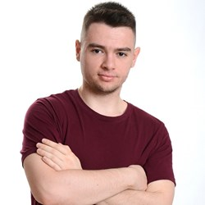
Atanas Atanasov
.NET Software Engineer at Fourth
End-to-End Restaurant and Hospitality Software
Working with .NET and JavaScript(Angular || React)
Technical Trainer @ SoftUni
100+ training sessions
Interested in the vast world of algorithms

Slide 13

Course Organization

Slide 14
Python Advanced Course
11-Jan-2022
19-Feb-2022
14-Apr-2022
Python Advanced
5 weeks * 4 times / week
12 credits
Start: 11-Jan-2022
Theoretical Exam: 19-Feb-2022
Practical Exam: 19-Feb-2022
Retake Exams
Theoretical Retake Exam: 14-Apr-2022
Practical Retake Exam: 14-Apr-2022

Slide 15

Homework Assignments & Exercises
Your homework is mainly work in class
Lesson days → slides + live demos + exercises
Exercise days → only exercises
How to submit your homework?
Submitted in the judge system
Do your homework when it's due
Assignments pile up quickly

Slide 16


SoftUni Certificate
Practical Exam 100%
Homework 5%
Evaluation
16

Slide 17
CPE Certificate
Practical Exam
Theoretical Exam
Evaluation
17

Slide 18


Course Web Site, Forum and FB Group
Official web site:
Softuni Python Community group:
https://softuni.bg/trainings/3590/python-advanced-january-2022
https://www.facebook.com/groups/SoftUniPythonCommunity

Slide 19
Questions?
Notes:
19

Slide 20
Trainings @ Software University (SoftUni)
Software University – High-Quality Education, Profession and Job for Software Developers
softuni.bg, softuni.org
Software University Foundation
softuni.foundation
Software University @ Facebook
facebook.com/SoftwareUniversity
Software University Forums
forum.softuni.bg
20
Notes:
20

Slide 21

License
This course (slides, examples, demos, exercises, homework, documents, videos and other assets) is copyrighted content
Unauthorized copy, reproduction or use is illegal
© SoftUni – https://about.softuni.bg
© Software University – https://softuni.bg
Notes:
21

